Slide 1
INDEX
2.Functional Requirements
3.Home Page
4.Webpage displaying information on selected Research
5.Opportunities
6.Publications
7.About page
8.Statistics
9.Administrator page

Slide 2
Functional requirements
1.To develop a robust web portal for researchers where they can have access to information regarding all the national and international grants available for them to carry out research activities more easily.
2.Types of users:Researchers,administrator
3.The Administrator can upload data sheets in csv file (or) excel sheet which possess the information about the grants available.
4.The Administrator can update the data sheets to remove or insert new information.
5.The Researcher(s) gain access to different types of grants,can search and download information based on different filters.They can also analyse data across different grant types.
6.Each research has it’s own page which has details like research prerequisites,grants,and others.

Slide 3
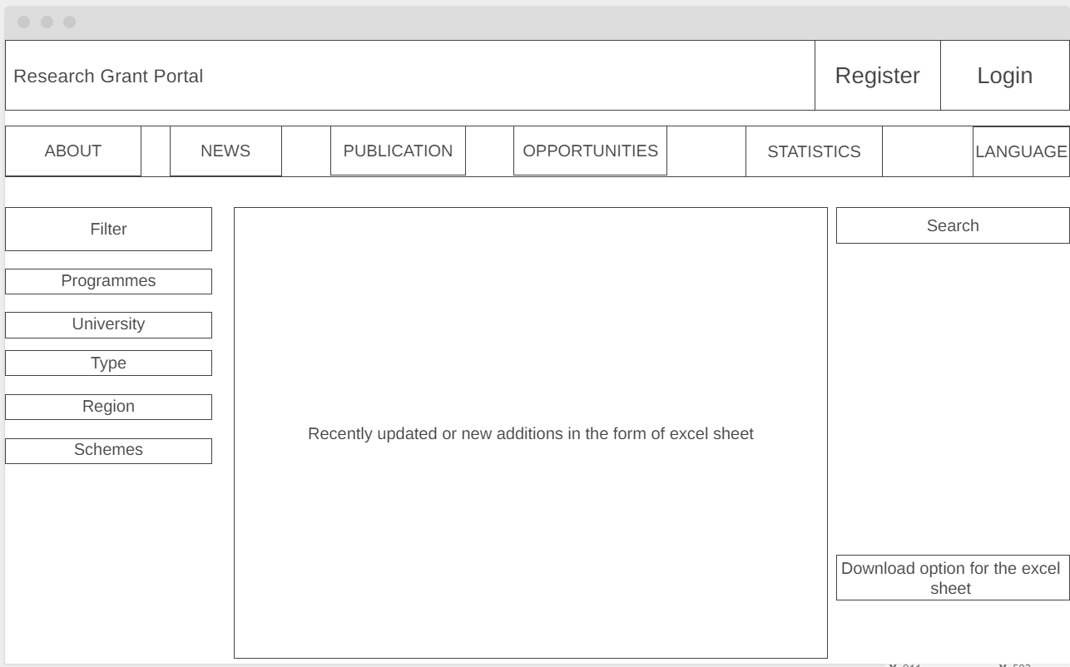
HOME PAGE

Slide 4
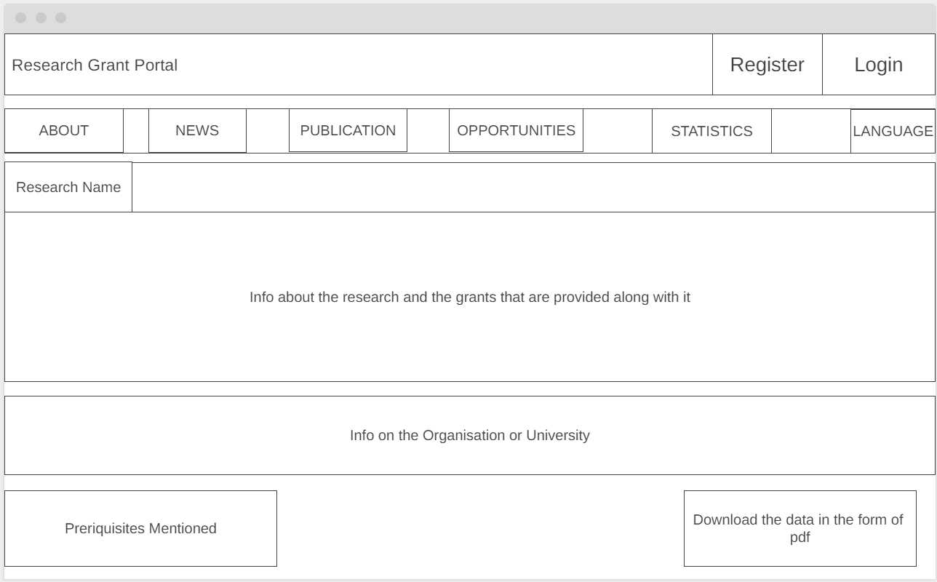

Slide 5
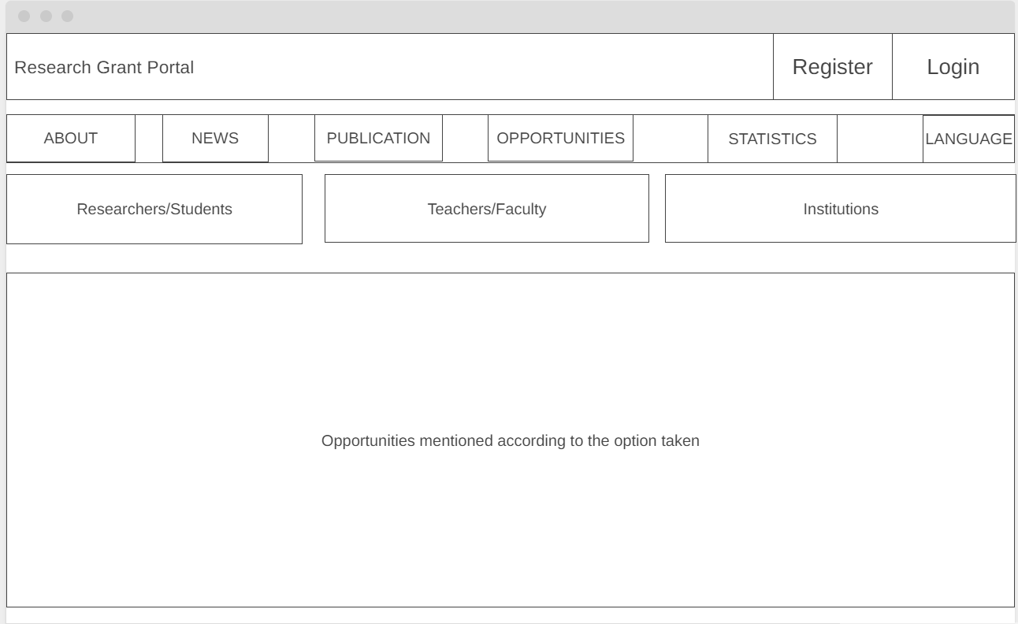

Slide 6
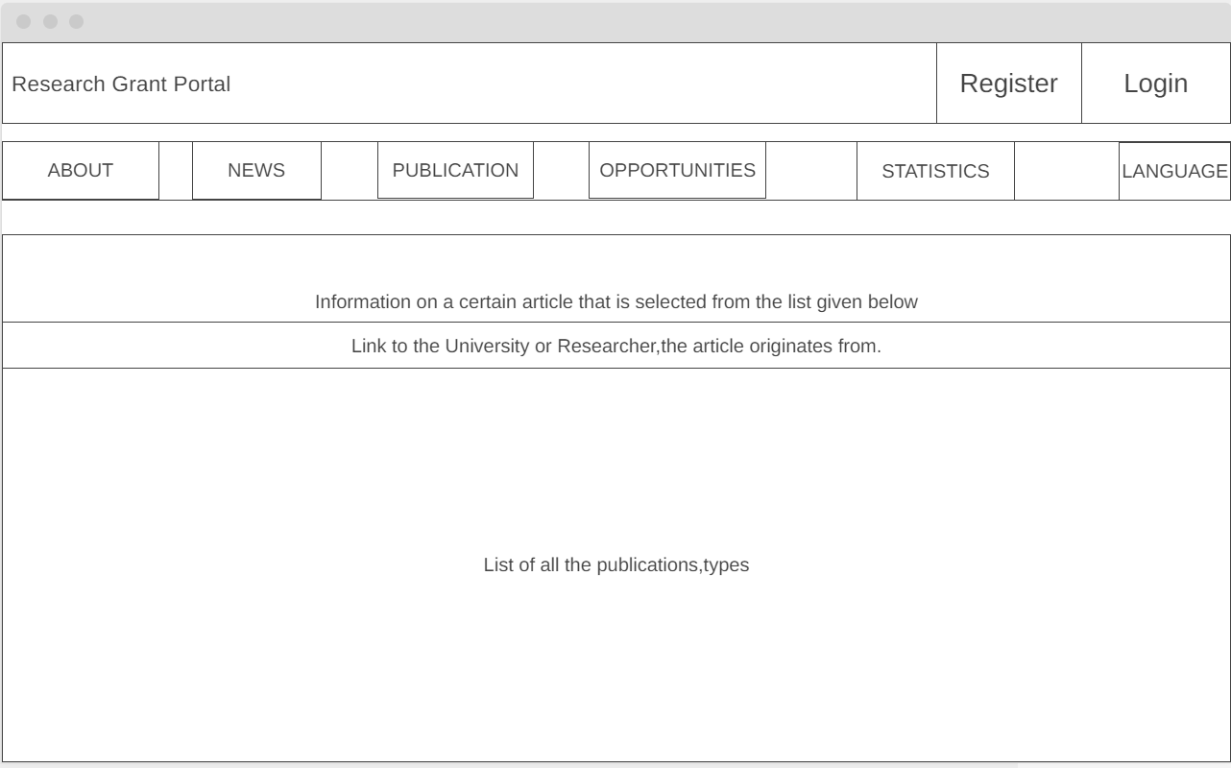

Slide 7
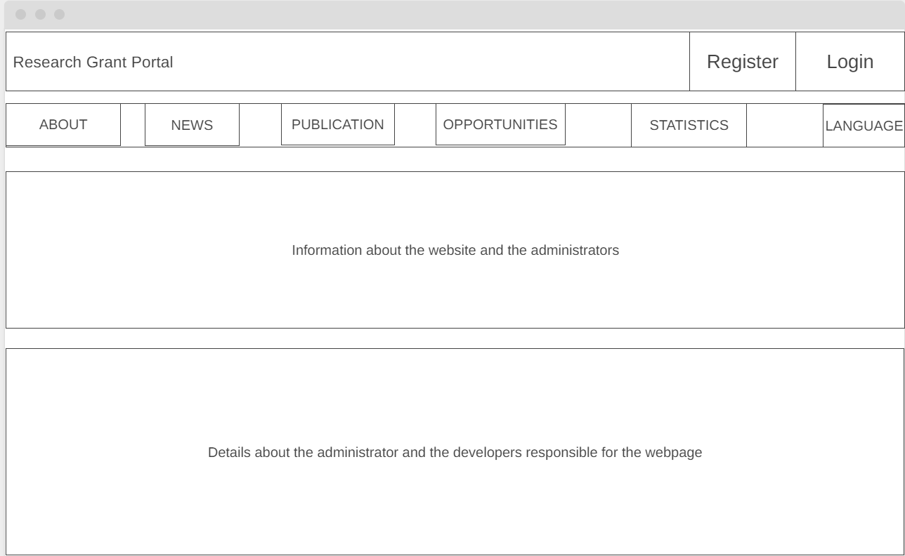

Slide 8
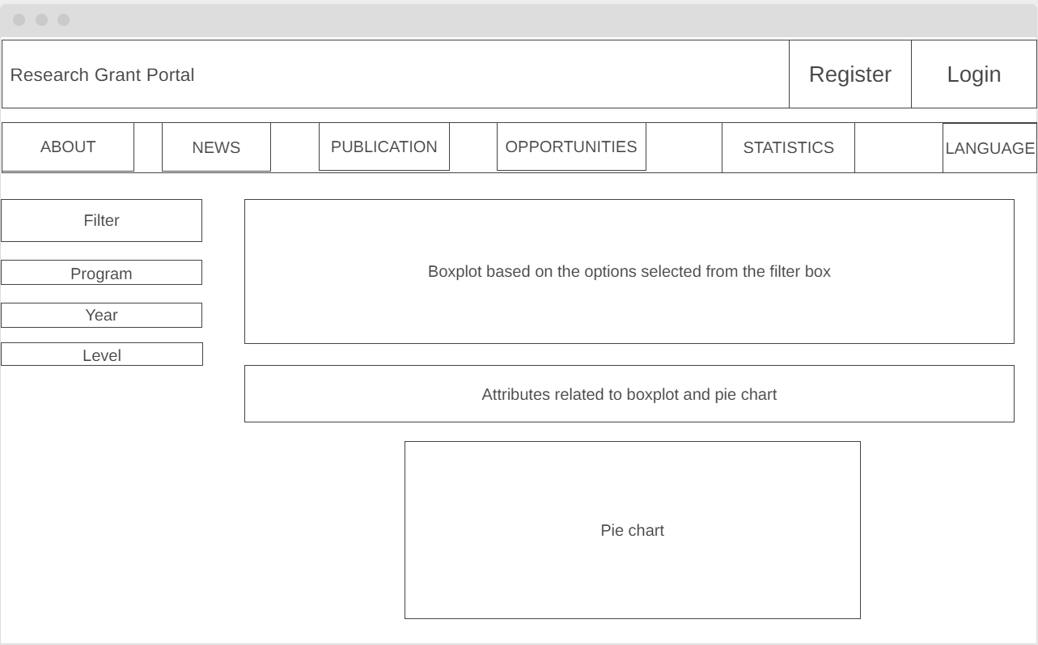

Slide 9
